Slide 1



Team Hunters
QA World cup 2023

Slide 2


Problems
OTT Automation Testing
Get Rank
Test Automation Strategy

Slide 3
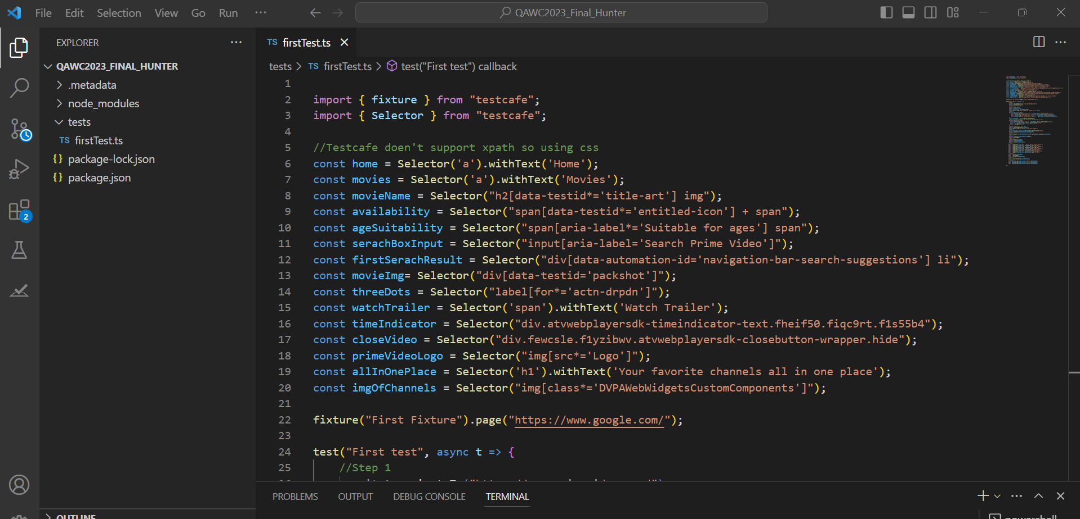
Prime Video Automation Testing
Tool Name - TestCafe And Typescript:

Slide 4
Get Nth Rank Student
Problem statement:
From a Class of X students, we need to know the student’s name, who has received nth rank in a subject.
We approached this problem by breaking down the problem statement into the following requirements:
There is one class which can have x number of students.
The students are taught y subjects.
Each student in the class has attained marks in each subject.
Next, we listed down the different use cases in a spreadsheet to make sure we cover everything.
Sno. | Subject | Rank | Total Students
1 | English | 1 | 5
2 | Math | 2 | 5
3 | "Blank" | Blank | Blank
4 | $%^^ | 1 | 5
5 | Math | "Blank" | 5
6 | Math | %%% | 5
7 | Math | 1 | $$
8 | Math | Two students with the same rank | 5
9 | Math | 6 | 5
10 | Math | 0 | 0

Slide 5
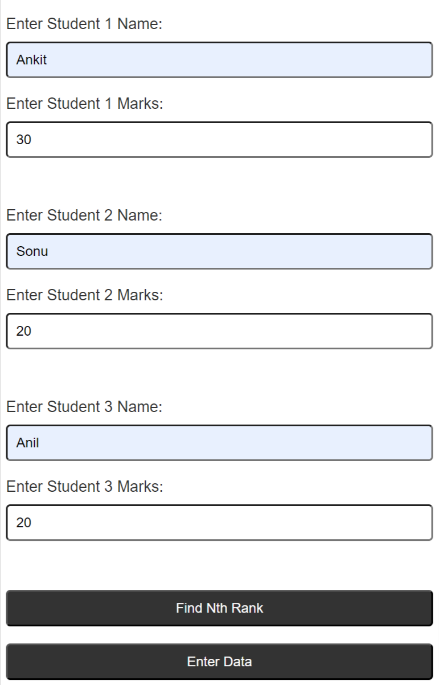
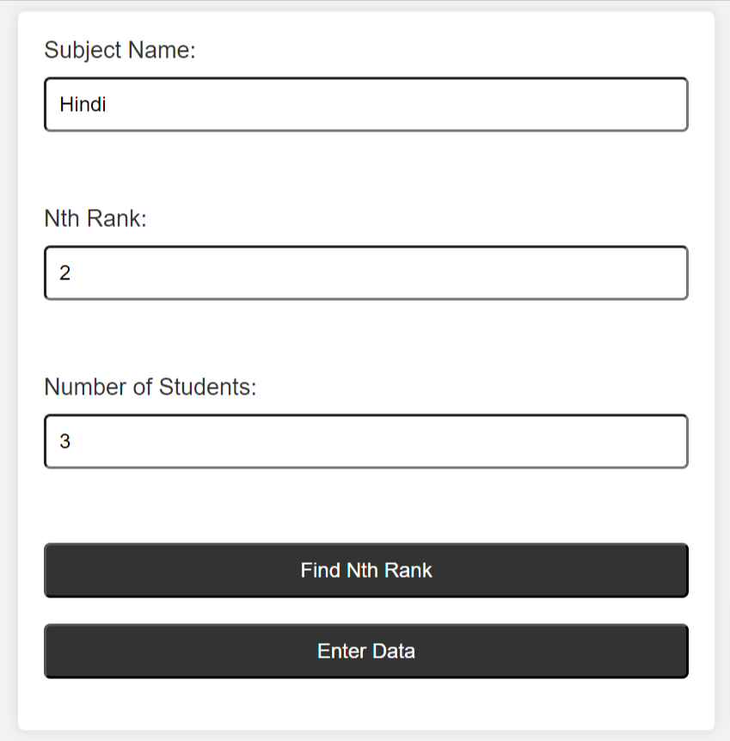

Here are the results:

Slide 6
Test Strategy Document for “GOOFY”
Approach:
Understanding the requirements and objectives of the Intelligent Virtual Assistant (IVA) and the expectations from the organization's stakeholders.
Identifying the potential risks, challenges, and complexities of the IVA in terms of its functionality, performance, security, and privacy.
Defining the scope of the testing and identifying the areas of the IVA that need to be tested, such as accuracy of responses, security of confidential information, usability, and compliance with data privacy regulations.
Developing test cases that cover all the identified areas of testing and using a combination of manual and automated testing approaches.
Defining key performance indicators (KPIs) that will be used to measure the performance and quality of the IVA over time.
Creating a test environment that simulates the production environment and includes various configurations of hardware, software, and network connectivity.

Slide 7
Challenges Faced::
The complexity of an IVA makes it challenging to test all possible scenarios and edge cases, which makes it difficult to ensure that the IVA is functioning accurately and securely.
The integration of the IVA with multiple systems and access to confidential information makes it critical to ensure that data privacy regulations such as GDPR are followed, which adds to the complexity of testing.
The use of AI in the IVA makes it challenging to predict the responses and behavior of the IVA, making it difficult to develop accurate and complete test cases.
The seamless user experience is critical for the success of the IVA, making it essential to test the usability and user experience of the IVA, which can be subjective and challenging to quantify.
The KPIs need to be defined carefully to ensure that they are meaningful and relevant, which requires a deep understanding of the objectives of the IVA and the expectations of the organization's stakeholders.

Slide 8

Thank you !

